Slide 1
Head-Up Display Alignment System
Group #65: Jiongcheng Luo, Krisna Irawan, Drew Hamm
Supervised by: Rockwell Collins

Slide 2
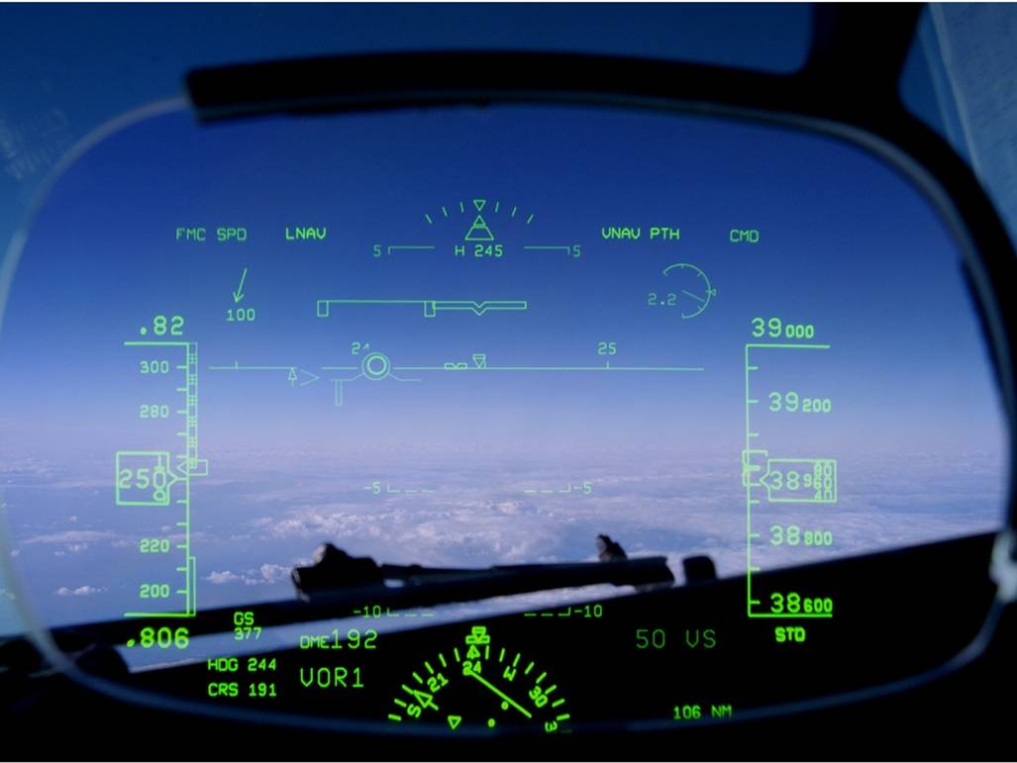
Head-Up Display (HUD) is a critical instrument in aviation field
A Head-up Display (HUD), is a transparent display that presents all necessary data that pilots need in their flight environment.
Accurate data is critical in the field of aviation as pilots rely heavily on their instruments to ensure flight safety.
Figure 1: A Head-up Display https://www.rockwellcollins.com/Data/News/2015_Cal_Yr/CS/FY15CSNR19-ChinaEastern.aspx.

Slide 3
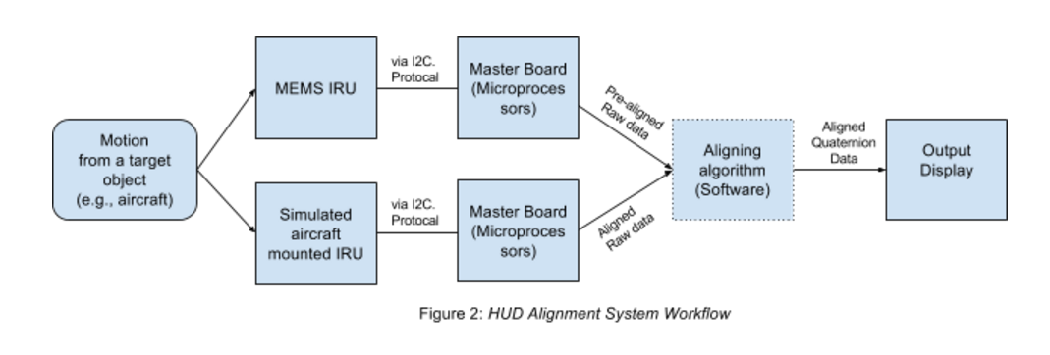
This project is a proof of concepts
We are working with Rockwell Collins through a proof of concept that explores a potential technological innovation for their Head-Up Display (HUD) systems.

Slide 4
What problem are we solving?
HUD installation is costly, time consuming and requires specialized equipment and epoxy.
Airframe droop reduces HUD accuracy during flight.

Slide 5
Find HUD Installation Alignment Error
Calculate alignment error by comparing HUD mounted sensor output to aircraft sensor output.
Find alignment error within 1 milliradian of accuracy.
Offer solution as an alternative method for HUD installation.

Slide 6
Find HUD Dynamic Alignment Error
Calculate alignment error by comparing HUD mounted sensor output to aircraft sensor output.
Find alignment error within 1 milliradian of accuracy.
Offer solution as a method that solves the airframe droop problem.

Slide 7
Communication Breakdown: Problems
Failed to demonstrate enthusiasm to clients.
Poorly written emails.
Miscommunication with clients in terms of project scope.
Poorly written problem statement.

Slide 8
Communication Breakdown: Solutions
Met with Professor Kevin and Dr. Winters.
Apologized to our client.
Changed workflow in terms of group to client communication.
Changed workflow in terms of document creation and submission.

Slide 9
Communication Breakdown: Results
Resolved miscommunication with clients.
Improved email comprehension and clarity.
Improved document quality.

Slide 10
Getting Behind In work: Problems
A consequence of our communication breakdown.
Both our problem statement and requirement documents were turned in late.

Slide 11
Getting Behind In work: Solutions
Maintained open line of communication with Professor Kevin and Dr. Winters.
Delegated tasks among group members.
Put in the extra work necessary to catch up.
Managed to get caught up.

Slide 12
Getting Behind In work: Results
Maintained our grade despite a few late submissions.
Managed to submit documents on time by the end of the term.

Slide 13
Preparation for Implementation
Acquire necessary Hardware (Microcontroller and IMU)
Get familiar with the Hardware
Get familiar with Arduino software
Notes:
Transition: we have been spending time on analyzing the problem, clarifying necessary requirement for the project, sorting out the technologies we are applying the project and the planning for design details. At this moment, we are on the stage of preparing for implementation, specifically…

Slide 14
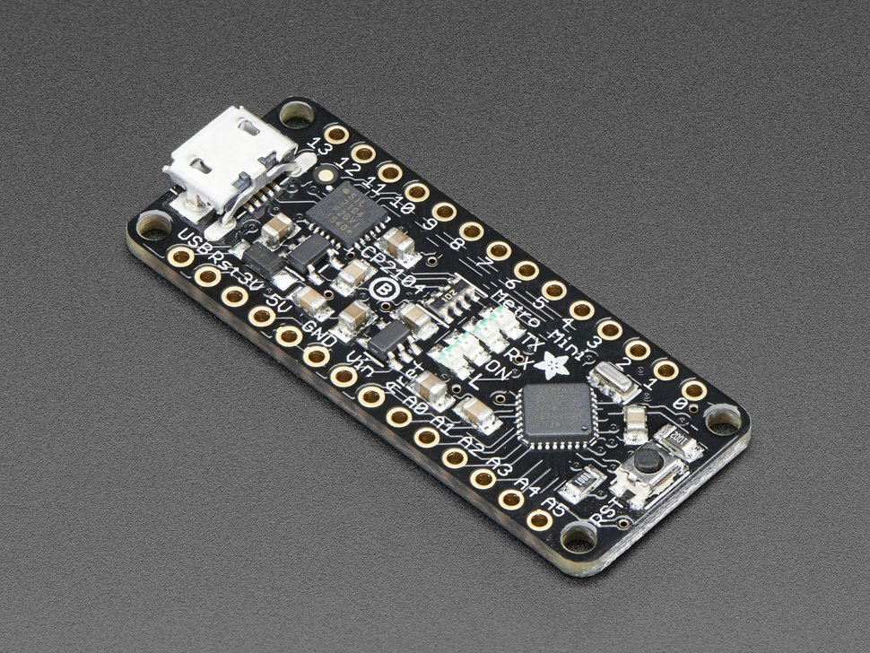
Microcontroller
Metro Mini 328
Source: https://www.adafruit.com/product/2590
Notes:
Recommended by our client, we have compared with other options like Arduino Pro Uno, the advantage of Metro is:

Slide 15
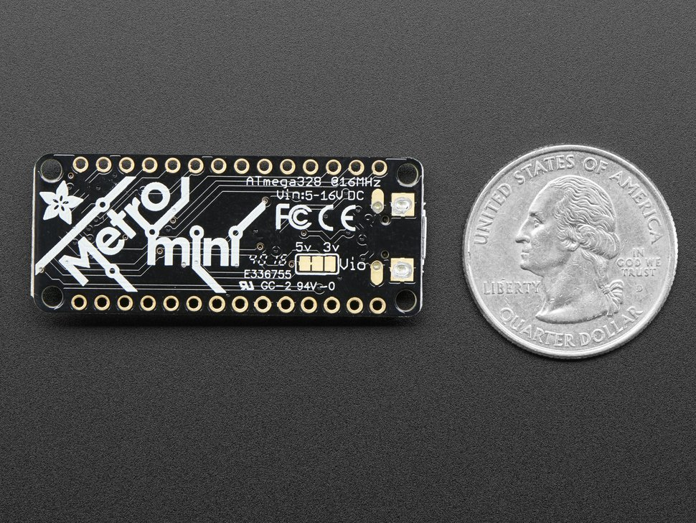
Why Metro Mini 328?
3.3/5V Operating Voltage
C in Arduino
Support I2C? Yes
Support USB? Yes
Source: https://www.adafruit.com/product/2590
Notes:
Voltage: most IMU requires low operating voltage like 3~3.3
Language: same as arduino uno: Atmega328 chip,
I2C: uses only two wires to connect with an IMU
USB: easy to implement on computer

Slide 16
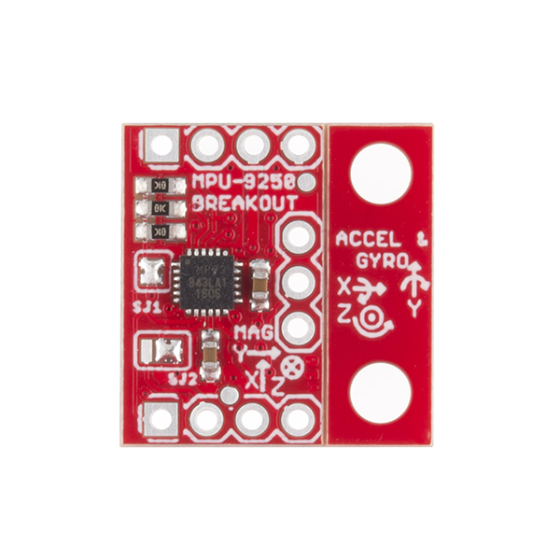
Inertial Measurement Unit (IMU)
MPU-9250
https://www.sparkfun.com/products/13762
Notes:
Invensense

Slide 17
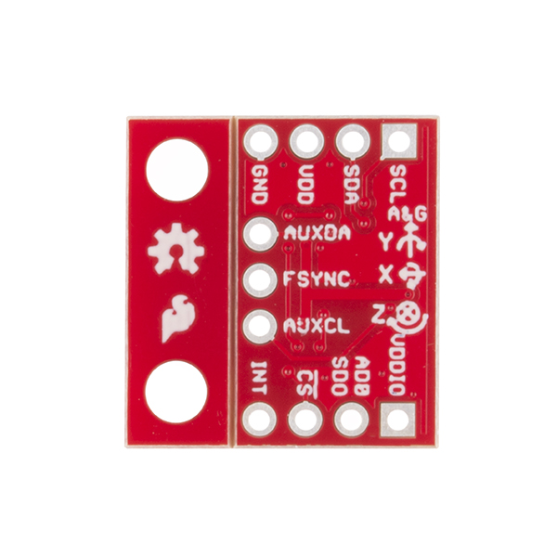
Why MPU-9250?
Accelerometer
Gyroscope
Compass
Support I2C? Yes
Support USB? Yes
https://www.sparkfun.com/products/13762
Notes:
9 axis: xyz axis in for each measure unit: provide more data for validating data accuracy

Slide 18

Why Arduino?
Notes:
Most Arduino chip support C language
Massive recourses and sample code online

Slide 19
Retrospective for the term as a group
Things that didn’t work so well this term:
Communication breakdown
Extension for assignment
Positive things that happens this term:
Clients satisfaction
Better understanding of the project

Slide 20
Things to move forward for winter term
Changes need to be implemented:
Think more deeply about our implementation details during winter break
Have a better working schedule for this class
Actions to create the necessary changes:
Do another run of research for the design documents during winter break
Recharge ourselves and fully commit to this project

Slide 21
Thank you for listening!

